Slide 1
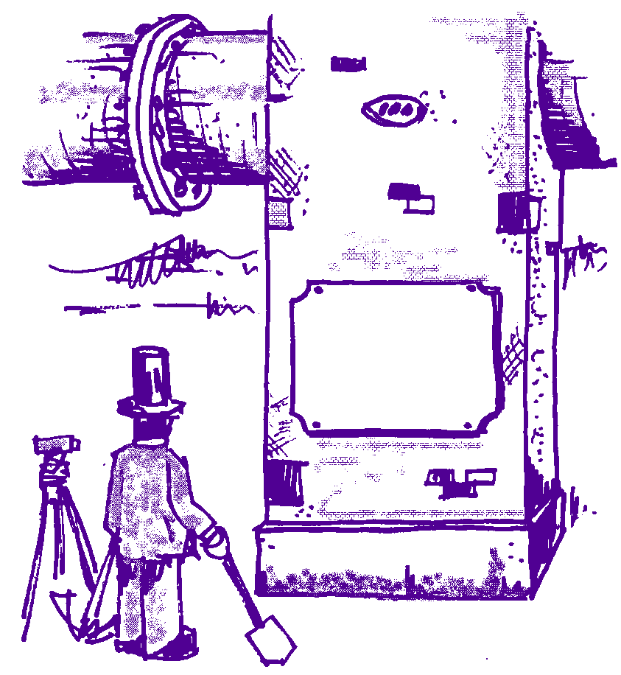
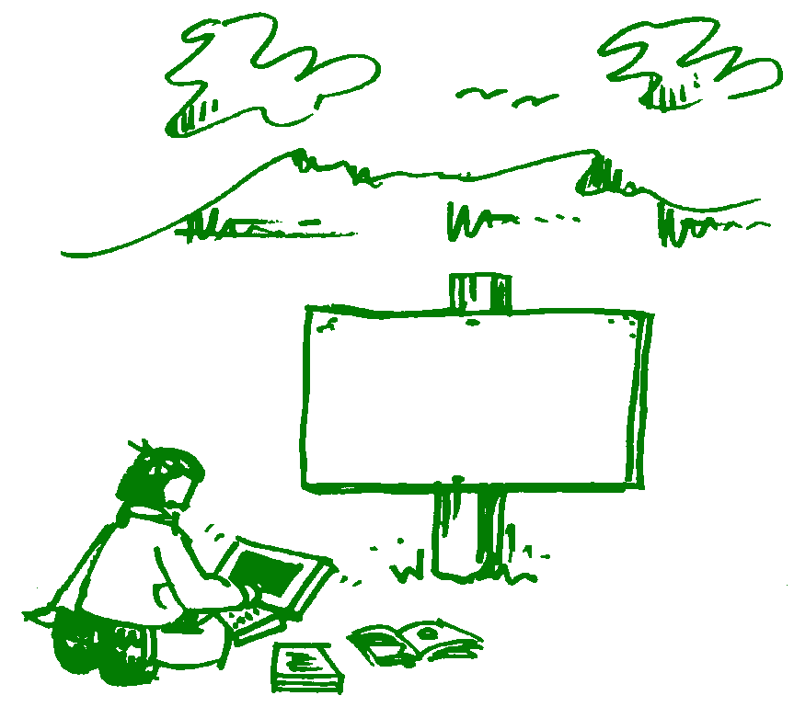
Holistic approach to problem identification and solution development through modelling shows a change in traditional engineering’s role
Refurbishing the minimum to meet society’s sustainable needs
Built by a Traditional Engineer
Not built by M. Hrncir New Engineer
Visible construction, at great public expense, to meet society’s wants

